Slide 1

Spotify Songs
Hsieh Boh Yang (U2122869J),
Tan Hong Zhao (U2121275C)
SC11
Notes:
Today, i will be presenting on my group’s Data Science project. This project was done by myself and Hong Zhao.

Slide 2

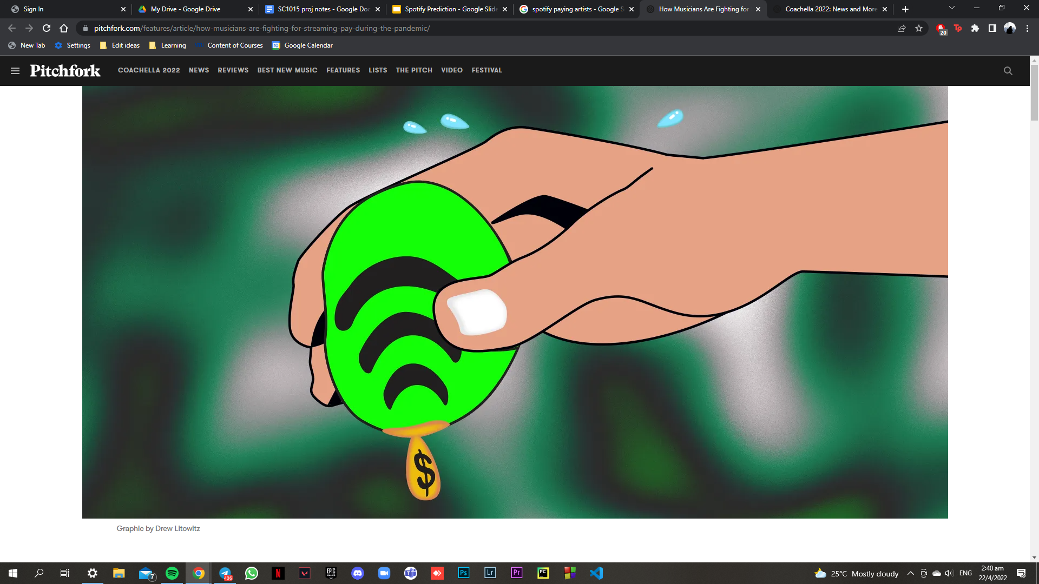
Spotify
82 Million songs on it’s platform
8 Million artists and creators
406 Million active monthly users
$0.0033 to $0.0054. That’s how much money Spotify paid artists per stream in 2021, according to Insider. That means it would take roughly 250 streams for an artist to earn $1
Notes:
Spotify is a digital music service that gives you access to millions of songs from creators all over the world. As of 2022, it has 82 million songs on its platform, an estimated 8 million artists and 406 million active monthly users. Ever wondered how much money your favourite artists and singers are earning from spotify for their songs? The answer is $0.0033 to $0.0054 per stream. That means it would take roughly 250 streams for an artist to earn $1

Slide 3
PROBLEM DEFINITION
What are the different variables that affect a song’s popularity on spotify? How can we then use this information to improve a song’s popularity?
Notes:
Popularity is a factor that affects the number of streams and an artist's revenue. Hence, they would need to know what variables affect the popularity of their songs! With that, we have our problem definition.What are the different variables that affect a song’s popularity on spotify? and How can we then use this information to improve a song’s popularity?

Slide 4
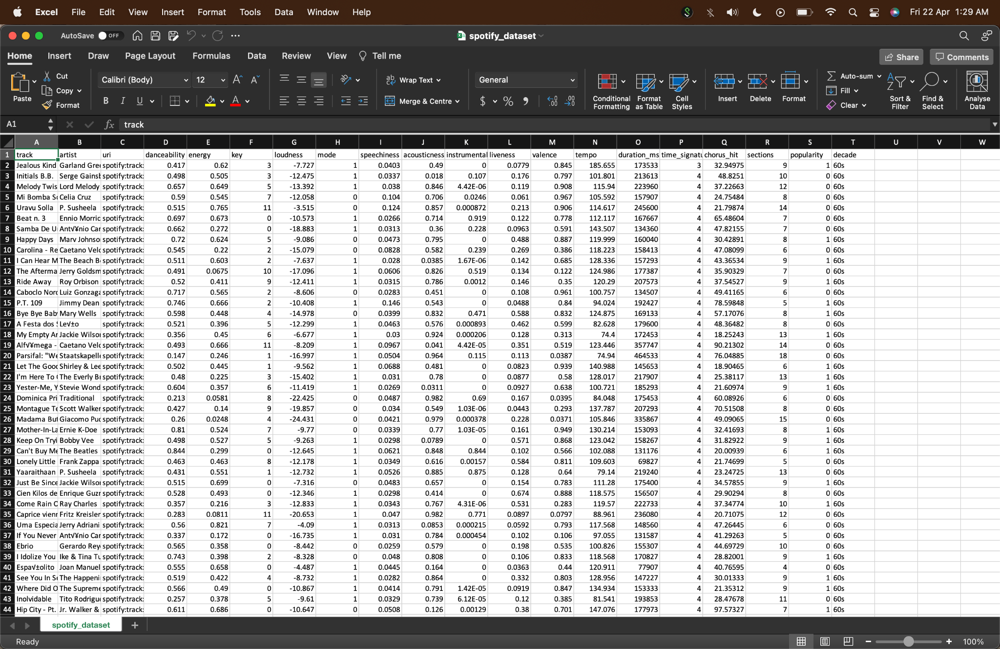
spotify_dataset.csv
Notes:
To help us with the problem, we worked on a dataset about the songs on spotify between the 1960s and 2010s. This is a screencapture of the first few rows of our raw dataset.

Slide 5
Data Cleaning & Preparation
Notes:
To start off, we had to do some data cleaning and preparation to create a more usable dataset.

Slide 6
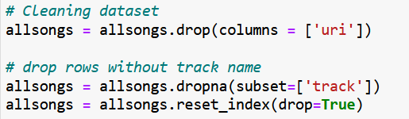
Cleaning Dataset
Notes:
We removed the entire "uri" column from the dataframe as it wasn't relevant for our prediction. We had also noticed that there were entries of songs without track names and we removed these entries from the dataframe as well.

Slide 7
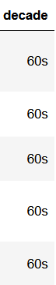
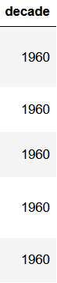
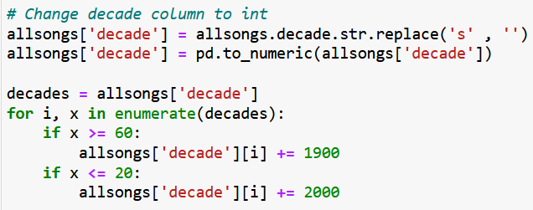
Decade -> Year
Notes:
For the column of “decade”. The data is as seen in the middle. In order to make the year more readable for viewers, we changed these values to reflect the first year of the decade.

Slide 8
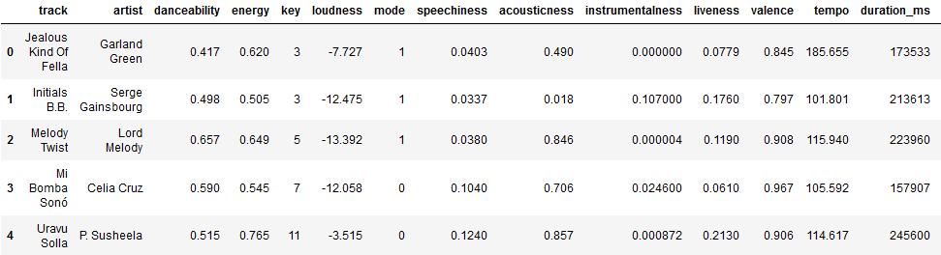
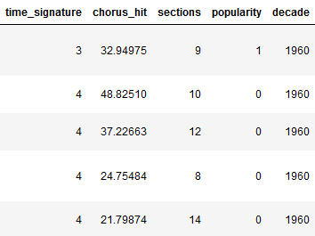
Cleaned Dataset
Notes:
Our cleaned dataset looked like this.

Slide 9
02
Exploratory Data Analysis
Notes:
With the data cleaned and prepared. We could perform exploratory data analysis on our dataset and subsequently present the visualisations.

Slide 10
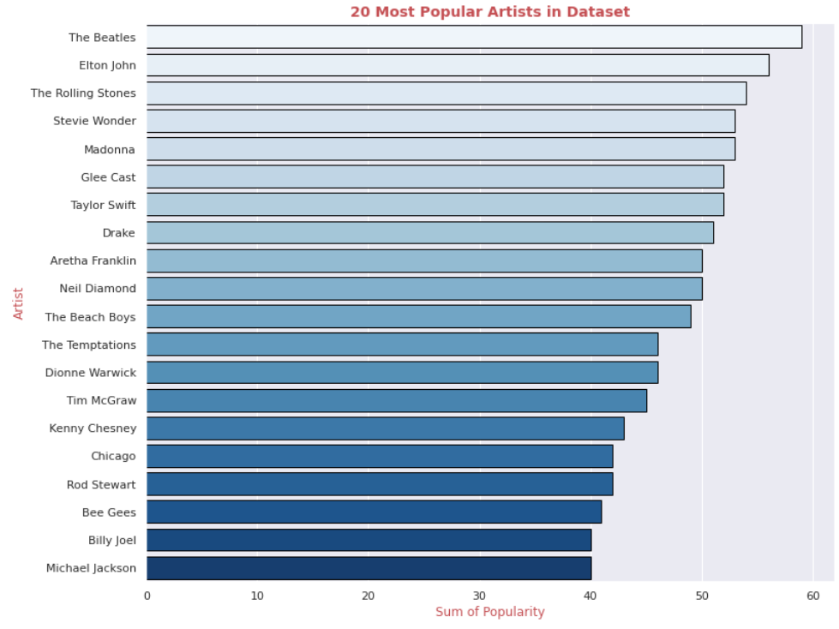
Notes:
This bar graph shows the top 20 most popular artists in the entire dataset based on the sum of popularity for the songs that they have released.

Slide 11
Song Traits
Key
Energy
Mode
Instrumentalness
Acousticness
Loudness
Danceability
Valence
Tempo
Popularity
Notes:
Within the dataset, these were the 10 variables / song traits that we were going to be working with.

Slide 12
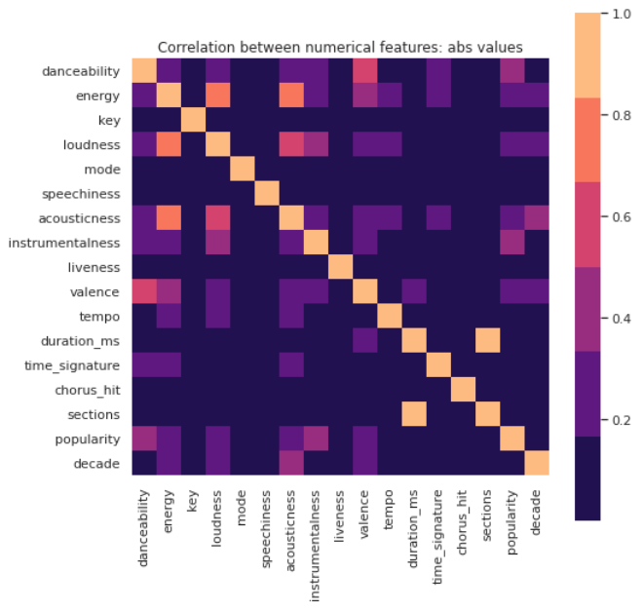
Numeric Heatmap
Notes:
We then charted a heatmap comparing the song traits, helping us to identify which variables were more closely correlated with the popularity of the song.

Slide 13
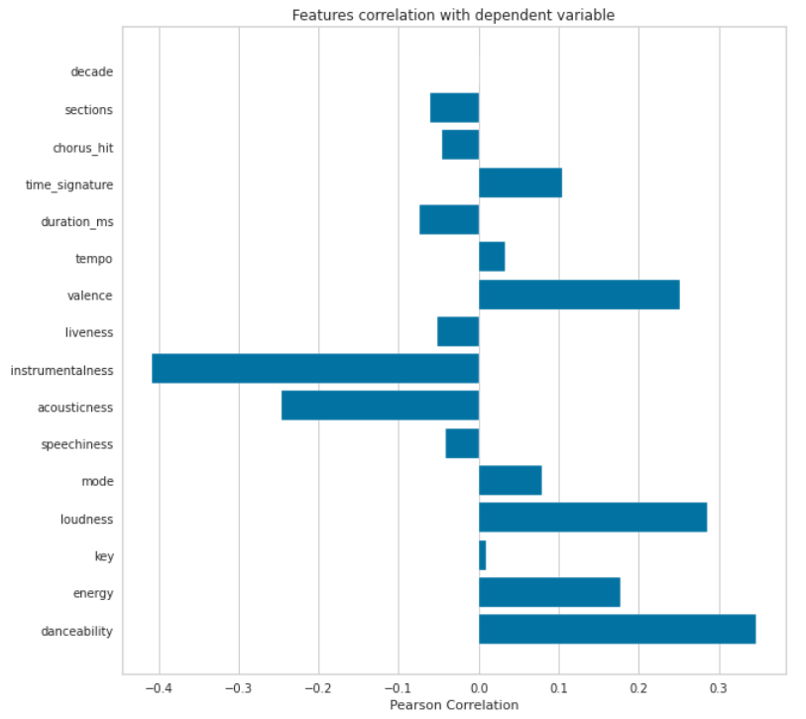
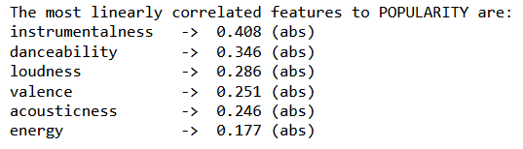
Song Traits correlation with popularity
Notes:
Next , we did the Pearson Correlation for all the various song traits against popularity. We then picked the 6 most linearly correlated features with popularity to explore further since they would be more useful.

Slide 14
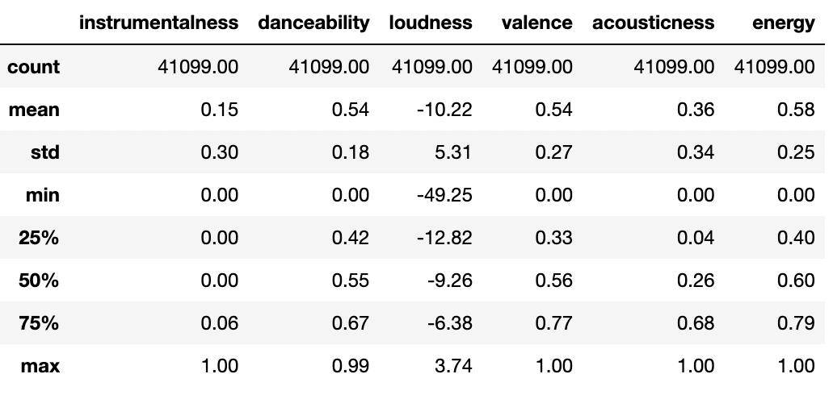
Summary Statistics
Notes:
We then printed out the summary statistics for these 6 variables to get a better understanding of how the data was spread out.

Slide 15
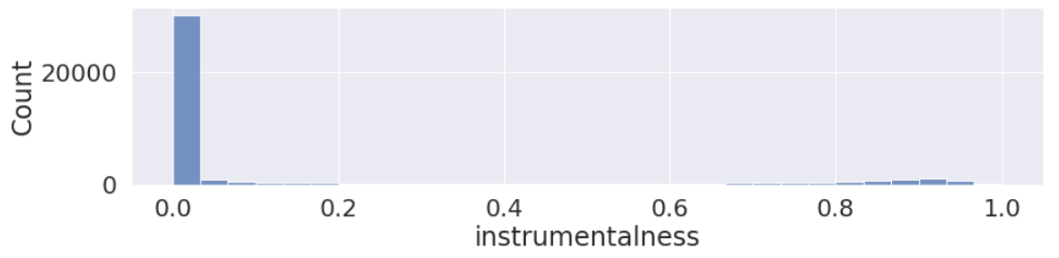
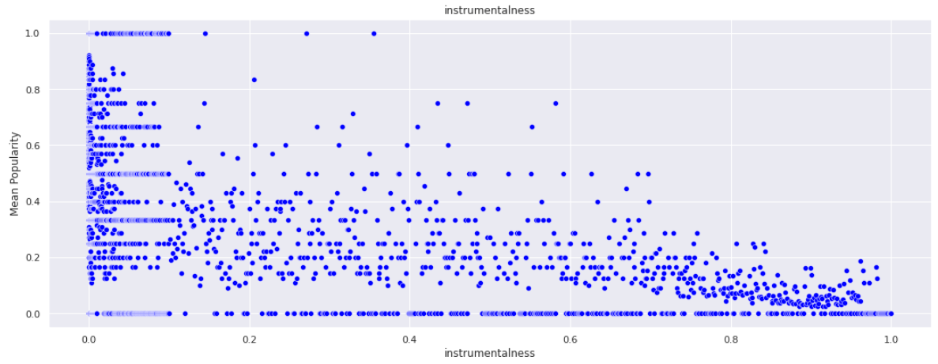
Instrumentalness
Notes:
These are the bivariate data analysis that we have ordered in decreasing correlation against popularity. For Instrumentalness. The closer the value to 1, the less the vocals in the song. We noticed that most songs have an instrumentalness very close to 0, but there's a small number of songs between 0.8 and 1. From the graph, a negative correlation can be seen quite easily. As instrumentalness increases, the mean popularity of the song tends to decrease.

Slide 16
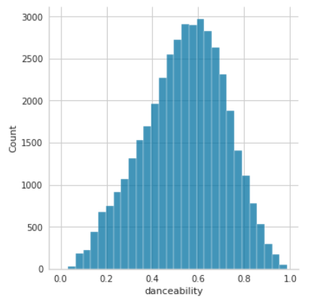
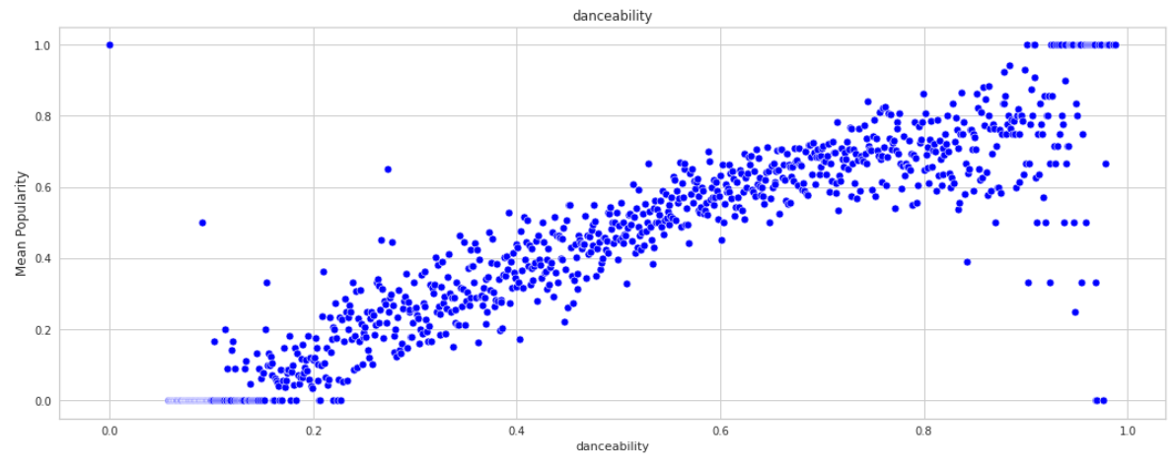
Danceability
Notes:
The next variable is danceability. From the histogram, we can see a normal distribution with the mode being about 0.6. There seems to be a clear relationship between danceability and the popularity of songs despite the presence of some outliers. The higher the danceability, the more likely the song will be popular

Slide 17
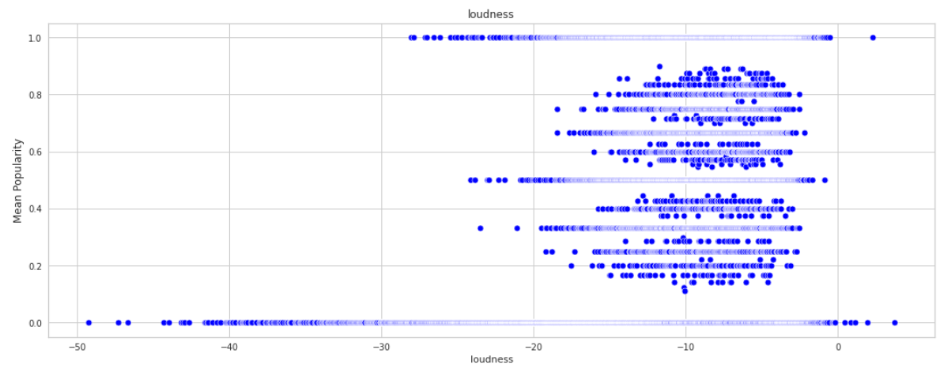
Loudness
Notes:
Next, loudness. Majority of the songs have a value of around -10 decibels. From the graph we aren’t able to see any trends and correlations.

Slide 18
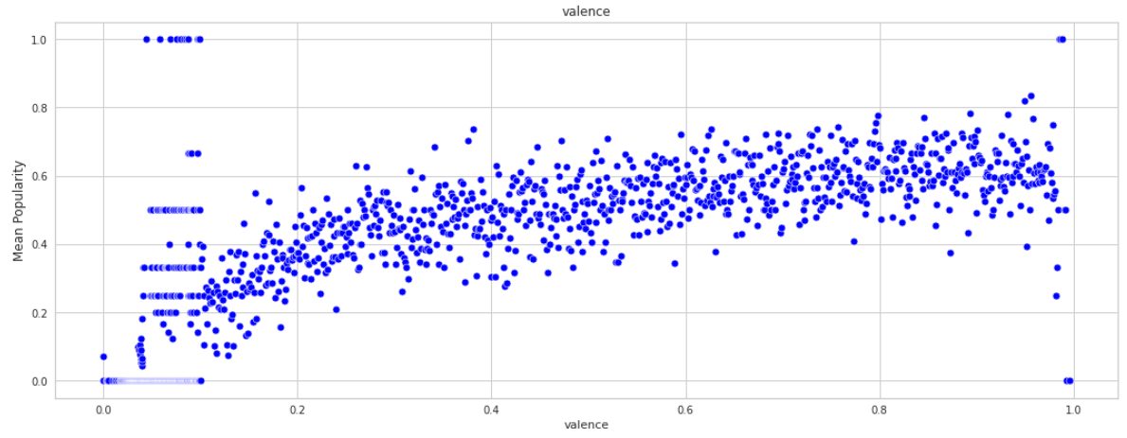
Valence
Notes:
Valence describes the musical positiveness conveyed by a track. Tracks with high valence sound more positive and these seem to be the ones that are slightly more popular

Slide 19
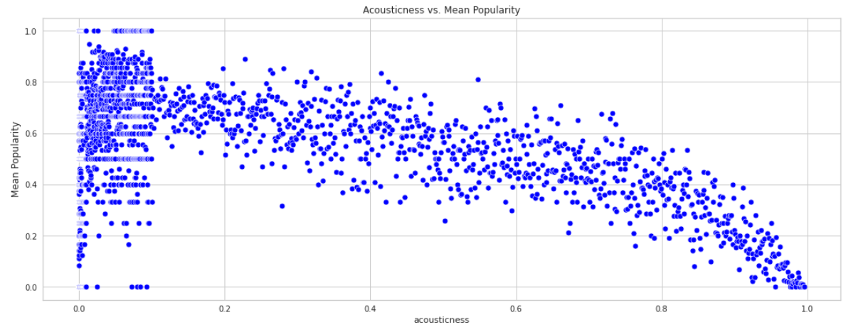
Acousticness
Notes:
Acousticness is a confidence measure from 0.0 to 1.0 of whether the track is acoustic. Most of the songs have an acousticness value close to 0 and there is a negative relationship between acousticness and popularity.

Slide 20
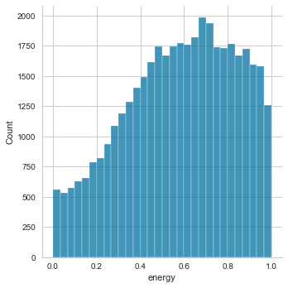
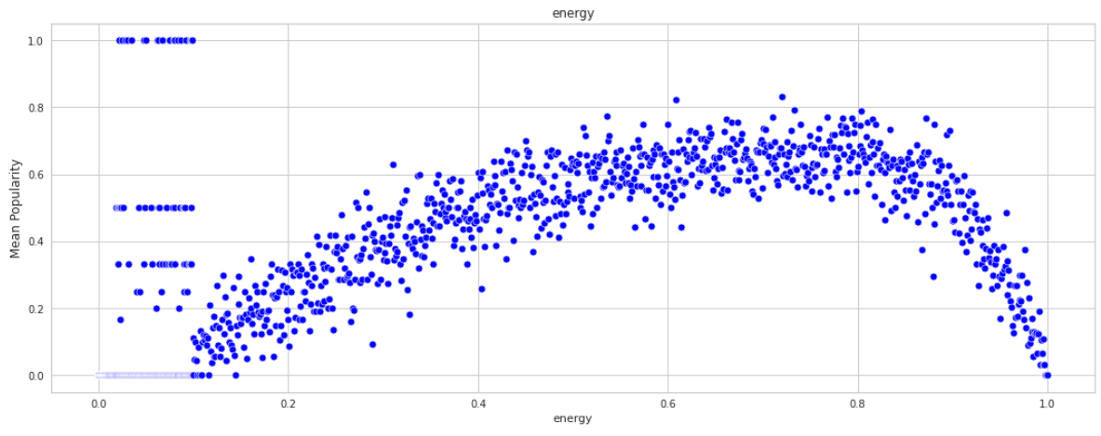
Energy
Notes:
Lasly, Energy. Most popular songs seem to have an energy value of around 0.6 - 0.8 and these are also the energy values that tend to have the highest popularity.

Slide 21
03
Machine Learning
Notes:
With the visualisations of the top 6 variables done, we moved on to use machine learning algorithms to try to predict if a song would be popular or not.

Slide 22
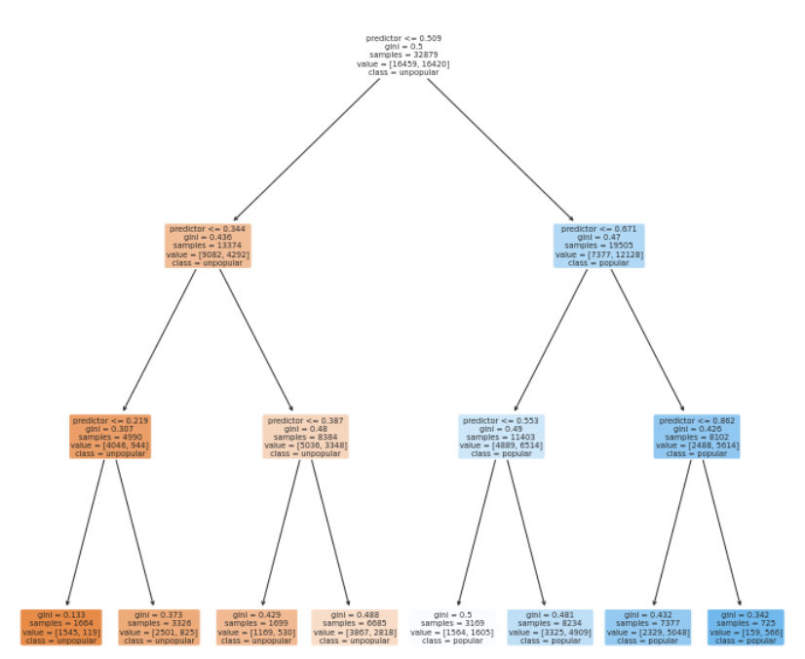
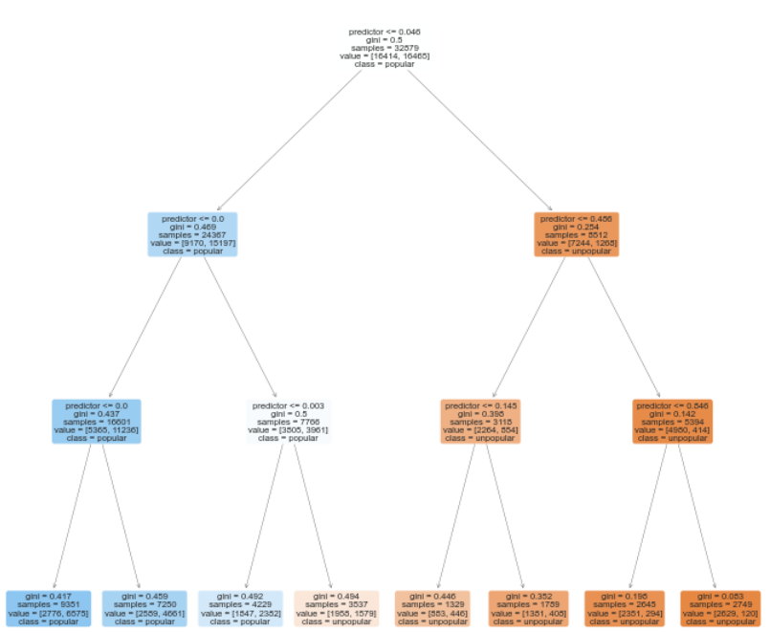
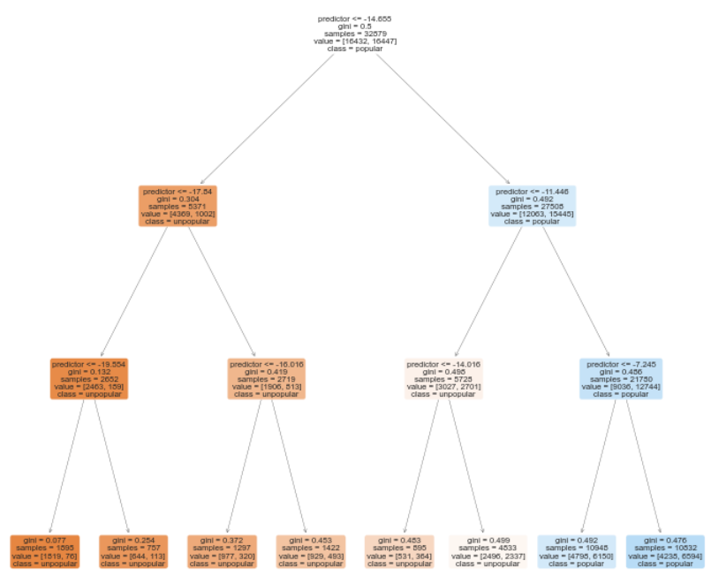
Decision tree
A type of Supervised Machine Learning Algorithm.
It can be explained by decision nodes and leaves. The leaves are the decisions made and the nodes are where the data is split
It is used to classify a categorical variable based on numeric data.
Danceability
Instrumentalness
Loudness
Notes:
To start off this portion, the machine learning tool that we utilised was the decision tree. The decision tree is a type of supervised machine learning where the data is continuously split according to a certain parameter. A decision tree is used for classifying a categorical response variable, such as popularity in our case, based on numeric data.
Below are some of the decision trees that we had and the others can be found in the jupyter notebook. In these decision trees, the darker the colour of the tree node , the more confident we are with the classification / prediction..

Slide 23
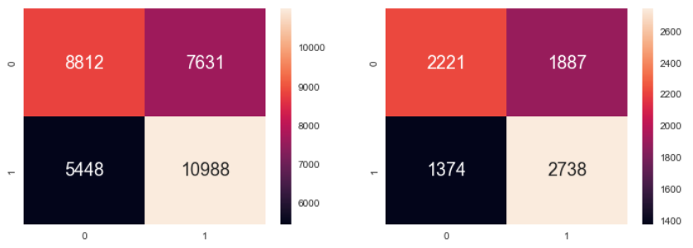
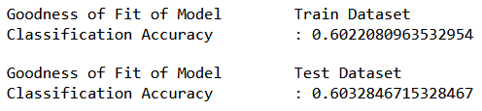
Valence
True Positive Rate: 59.0%
False Positive Rate: 38.2%
True Negative Rate: 61.8%
False Negative Rate:41.0%
True Positive Rate: 59.2%
False Positive Rate: 38.2%
True Negative Rate: 61.8%
False Negative Rate: 40.8%
Notes:
Based on each of the decision trees, we then used the confusion matrix to help us evaluate the performance of our model, using the metrics that we have calculated above. Due to the random train test split, the results that we obtained everytime we refreshed the notebook differed slightly by about 1%, but we are still able to draw conclusions from the results. As expected, the classification accuracy of the model on the train data set would be higher than that of the test dataset since the train dataset was used to build the model. However, the difference in accuracy between them were relatively small, between 1-2%.
We arranged the variables in the slides in ascending classification accuracy, with valence having the lowest accuracy of 60.3% on the test dataset.

Slide 24
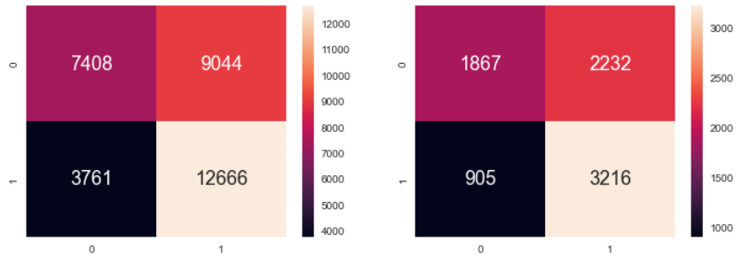
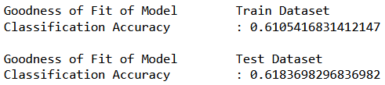
Loudness
True Positive Rate: 58.3%
False Positive Rate: 33.6%
True Negative Rate: 66.4%
False Negative Rate: 41.7%
True Positive Rate: 59.0%
False Positive Rate: 32.6%
True Negative Rate: 67.4%
False Negative Rate: 41.0%
Notes:
The next variable was loudness with a classification accuracy of 61.8% on the test dataset.

Slide 25
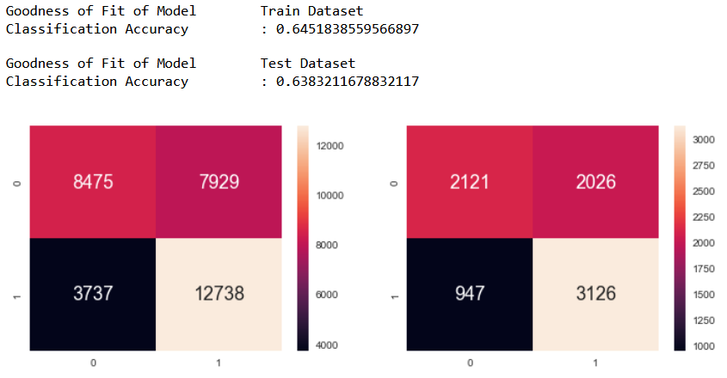
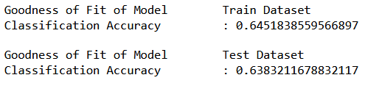
Danceability
True Positive Rate: 61.6%
False Positive Rate: 30.6
True Negative Rate: 69.4%
False Negative Rate: 38.4%
True Positive Rate: 60.6%
False Positive Rate: 30.8%
True Negative Rate: 69.2%
False Negative Rate: 39.4%
Notes:
Danceability, with a classification accuracy of 63.8%

Slide 26
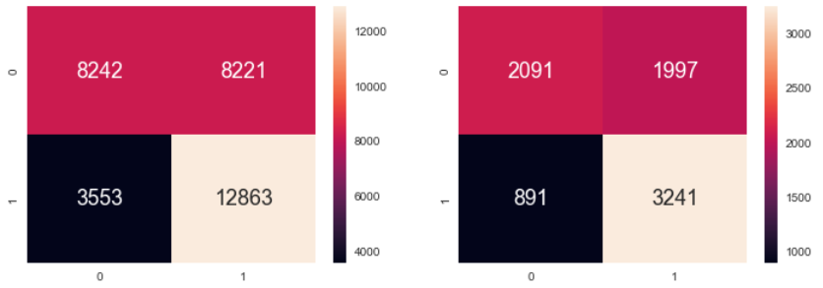
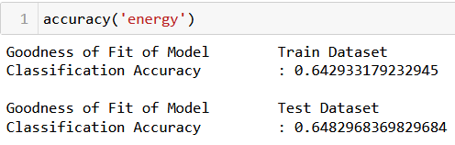
Energy
True Positive Rate: 61.0%
False Positive Rate: 30.1%
True Negative Rate: 69.9%
False Negative Rate: 39.0%
True Positive Rate: 61.8%
False Positive Rate: 39.8%
True Negative Rate: 60.2%
False Negative Rate:38.2%
Notes:
Energy, with a classification accuracy of 64.8%

Slide 27
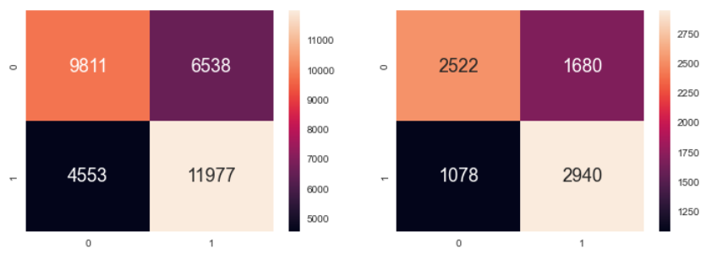

Acousticness
True Positive Rate: 64.7%
False Positive Rate: 31.7%
True Negative Rate: 68.3%
False Negative Rate: 35.3%
True Positive Rate: 63.6%
False Positive Rate: 30.0%
True Negative Rate: 70.0%
False Negative Rate: 36.4%
Notes:
Acousticness, with a classification accuracy of 65.9%. It is also the variable with the best true positive and true negative rates

Slide 28
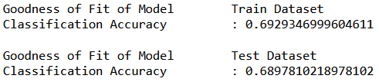
Instrumentalness
True Positive Rate: 61.0%
False Positive Rate: 30.1%
True Negative Rate: 69.9%
False Negative Rate: 39.0%
True Positive Rate: 61.8%
False Positive Rate: 29.8%
True Negative Rate: 70.2%
False Negative Rate: 38.2%
Notes:
And lastly instrumentalness, with the highest classification accuracy out of all 6 variables at 68.9%

Slide 29
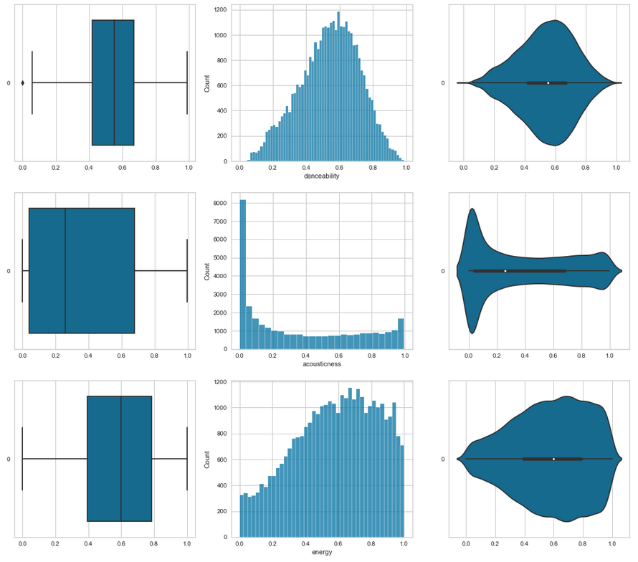
Multivariate Decision Tree
Response Variable : popularity
Predictor Feature : danceability, acousticness, energy
Notes:
After using the univariate decision trees, we realised that the classification accuracy of the model was not very high. Hence we used the multivariate classification tree using danceability, acousticness and energy as predictors. The graphs on the left are some of the univariate visualisations for these variables.

Slide 30
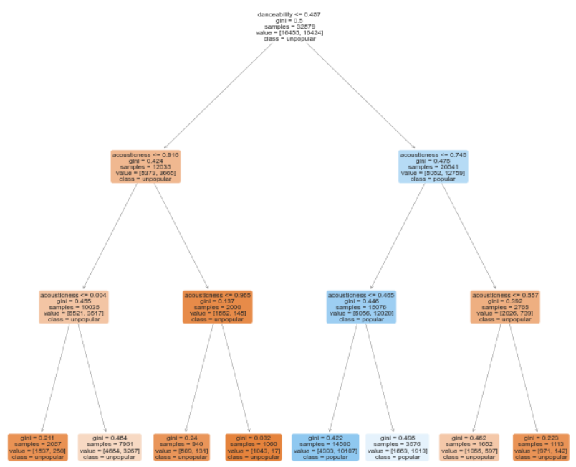
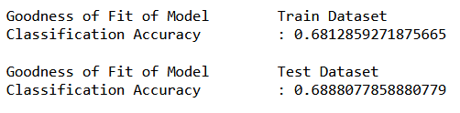
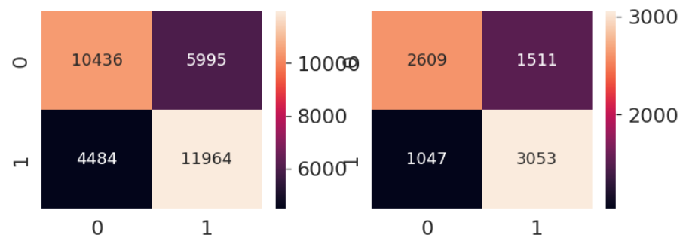
Multivariate Decision Tree
Notes:
These were our results for the multivariate decision tree. The model had a classification accuracy of 68.9%, which is exactly the same as the decision tree built using intrumentalness, which is higher than the classification accuracies of all the other variables. However, after re-running the jupyter notebook multiple times to vary the train test split, the multi-variate decision tree is able to consistently produce a greater classification accuracy than that of the univariate one. Hence, as compared to a univariate decision tree, a multivariate one would be a better model, with its greater consistency and accuracy.

Slide 31
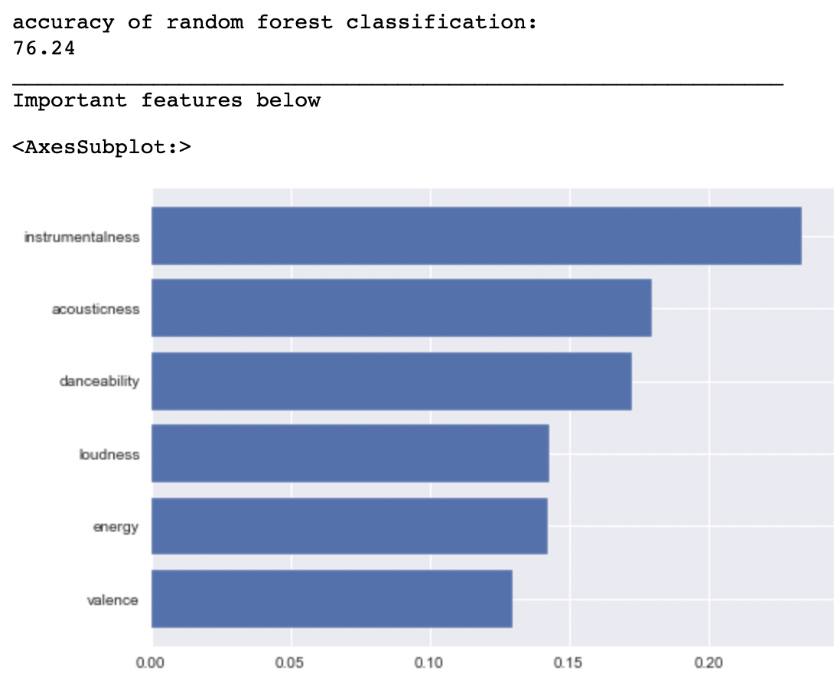
Random Forest Classifier
Notes:
To further improve on the accuracy of our prediction. We used another machine learning algorithm, namely the random forest classifier. The random forest algorithm is another supervised machine learning algorithm, which builds multiple decision trees based on different samples and takes their majority vote for classification. Basically each unique decision tree is built and the prediction with the greatest number will be taken as the final prediction. After using the random forest classifier, we were able to achieve an accuracy of 76.4, significantly greater than that of a decision tree. We then plotted a graph to compare which of the variables were the most important during the prediction.

Slide 32
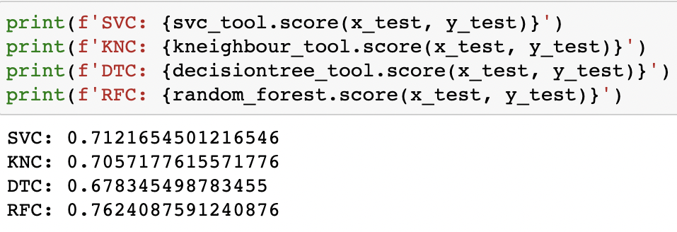
Other machine learning tools
Notes:
To see if there were other better algorithms that might be a better model, we used a few others such as Support vector clustering / SVC for short as well as the kneighbours classifier (KNC for short). These were the accuracy results that were obtained. We are able to see that the decision tree provides us with the lowest accuracy of 67%, followed by KNC and SVC at 70 and 71% respectively and lastly the random forest classifier which had the highest accuracy, making it the best model to use.

Slide 33
Our take away and learning from this project
New data visualization and machine learning tools such as Random Forest and WordCloud
Outcome of project:
Provide artists with a better idea of how to better produce their songs if they are looking to increase their songs’ popularity and in turn generate more revenue for themselves.
Identifying current trends in pop songs and to adjust marketing strategy accordingly.
Data driven insights:
Instrumentalness is the most important factor in predicting the popularity of the song.
Notes:
To conclude this presentation, these are some of our group’s takeaways and learning. We have learnt new data visualisation and machine learning algorithms such as random forest classifier and wordcloud. From this project, we are able to Provide artists with a better idea of how to better produce their songs if they are looking to increase their songs’ popularity and in turn generate more revenue for themselves. We were also able to identify the current trends in music and this can allow for adjustments in marketing strategies if needed. Our data driven insight is that Instrumentalness is the most important factor in predicting the popularity of the song. More specifically, a lower instrumentalness, meaning more vocals is more popular with listeners.
Our model is not perfect and there are many other factors that were not accounted for, like the theme of the song, popularity of the music artist, and the shift in trends of music over the decades. Despite these limitations, our model provides a good starting point for exploring how different song traits impact the popularity of a song.

Slide 34
References
https://www.forbes.com/sites/marisadellatto/2022/03/24/spotify-says-it-paid-7-billion-in-royalties-in-2021-amid-claims-of-low-pay-from-artists/?sh=2062a500a0db
https://www.latimes.com/visuals/graphics/la-sci-g-music-evolution-20150505-htmlstory.html/
https://pitchfork.com/features/article/how-musicians-are-fighting-for-streaming-pay-during-the-pandemic/
Notes:
These are some of our references for this presentation

Slide 35
Thank you
Notes:
Thank you for watching our presentation.

